Slide 1
Maths Explained
Key Stage Two

Slide 2
Addition and Subtraction Year 3 & 4
In Year 3 especially, the column methods are built up gradually. Children will develop their understanding of how each stage of the calculation, including any exchanges, relates to place value. The example calculations chosen to introduce the stages of each method may often be more suited to a mental method. However, the examples and the progression of the steps have been chosen to help children develop their fluency in the process, alongside a deep understanding of the concepts and the numbers involved, so that they can apply these skills accurately and efficiently to later calculations. The class should be encouraged to compare mental and written methods for specific calculations, and children should be encouraged at every stage to make choices about which methods to apply.
In Year 4, the steps are shown without such fine detail, although children should continue to build their understanding with a secure basis in place value. In subtraction, children will need to develop their understanding of exchange as they may need to exchange across one or two columns.
By the end of Year 4, children should have developed fluency in column methods alongside a deep understanding, which will allow them to progress confidently in upper Key Stage 2.
Notes:
Information taken from the Power Maths Calculation Policies for Upper and Lower Key Stage Two

Slide 3
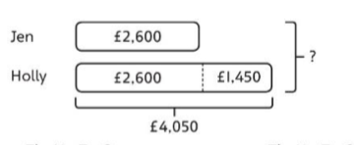
Addition and Subtraction Year 5 & 6
Addition and subtraction: Children build on their column methods to add and subtract numbers with up to seven digits, and they adapt the methods to calculate efficiently and effectively with decimals, ensuring understanding of place value at every stage.
Children compare and contrast methods, and they select mental methods or jottings where appropriate and where these are more likely to be efficient or accurate when compared with formal column methods.
Bar models (such as the one below) are used to represent the calculations required to solve problems and may indicate where efficient methods can be chosen.

Slide 4
Multiplication and Division Year 3 & 4
Children build a solid grounding in times-tables, understanding the multiplication and division facts in tandem. As such, they should be as confident knowing that 35 divided by 7 is 5 as knowing that 5 times 7 is 35.
Children develop key skills to support multiplication methods: unitising, commutativity, and how to use partitioning effectively.
*Unitising allows children to use known facts to multiply and divide multiples of 10 and 100 efficiently.
*Commutativity gives children flexibility in applying known facts to calculations and problem solving.
*An understanding of partitioning allows children to extend their skills to multiplying and dividing 2- and 3-digit numbers by a single digit. Children develop column methods to support multiplications in these cases.
For successful division, children will need to make choices about how to partition. For example, to divide 423 by 3, it is effective to partition 423 into 300, 120 and 3, as these can be divided by 3 using known facts.
Children will also need to understand the concept of remainder, in terms of a given calculation and in terms of the context of the problem.

Slide 5
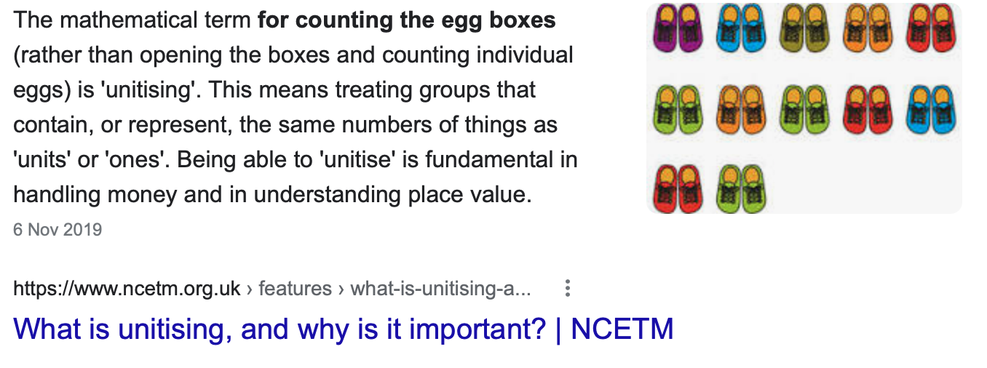
Unitising

Slide 6
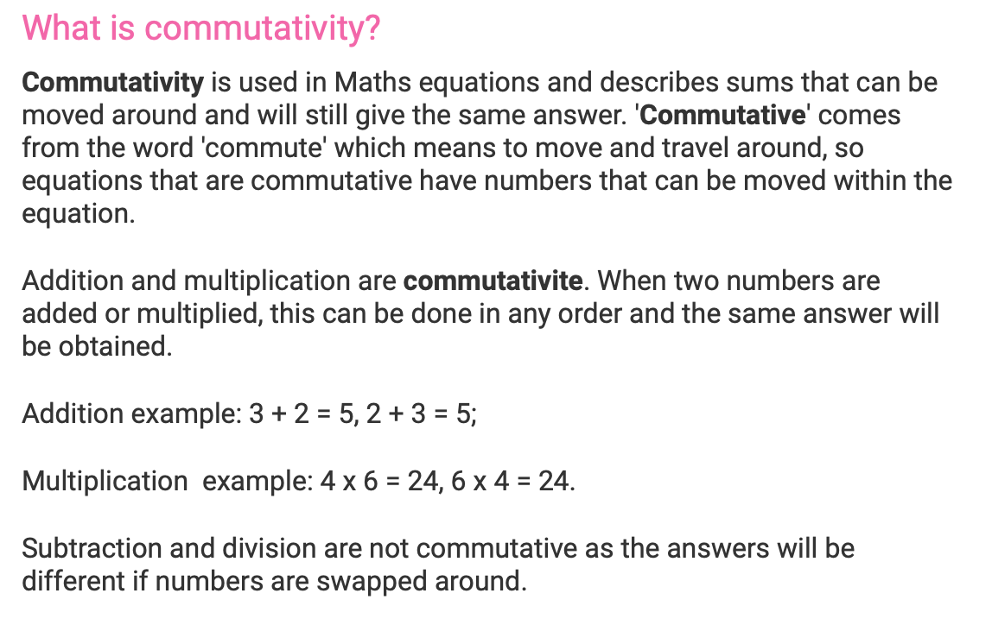
Commutativity
Notes:
https://www.twinkl.co.uk/teaching-wiki/commutativity

Slide 7
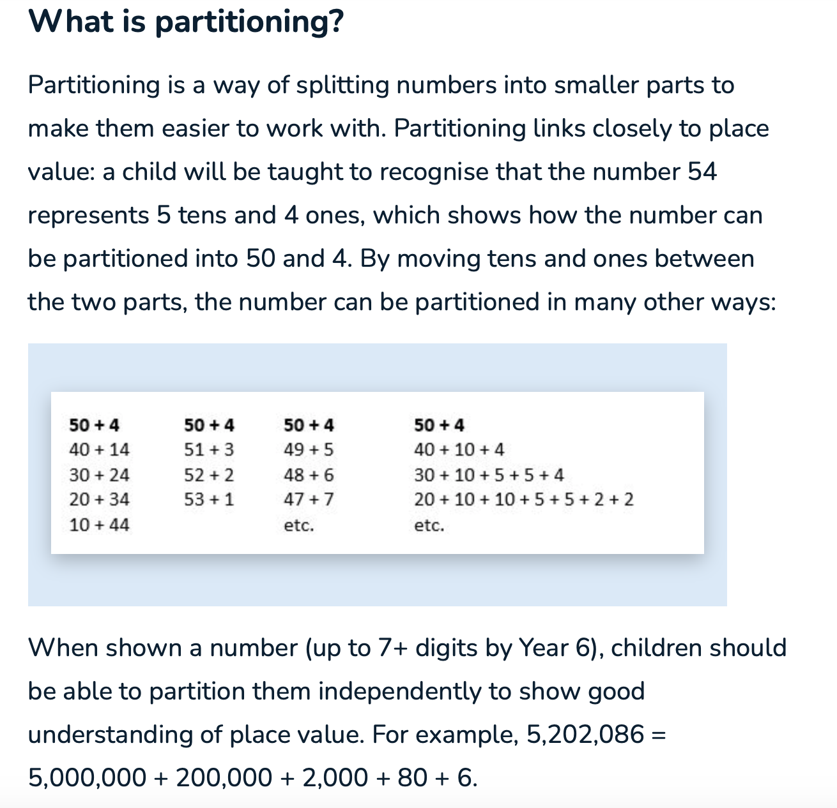
Partitioning
Notes:
https://thirdspacelearning.com/blog/what-is-partitioning/

Slide 8
Multiplication and Division Year 5 & 6
Multiplication and division: Building on their understanding, children develop methods to multiply up to 4-digit numbers by single-digit and 2-digit numbers.
Children develop column methods with an understanding of place value, and they continue to use the key skill of unitising to multiply and divide by 10, 100 and 1,000.
Written division methods are introduced and adapted for division by single-digit and 2-digit numbers and are understood alongside the area model and place value. In Year 6, children develop a secure understanding of how division is related to fractions.
Multiplication and division of decimals are also introduced and refined in Year 6.

Slide 9
This link https://www.bbc.co.uk/bitesize/articles/z4chnrd
Takes you to a video which clearly explains the written method for long multiplication.

Slide 10
This link: https://thirdspacelearning.com/blog/guide-division-for-kids-explained/
Will take you to a really useful website which will recap methods that you may not have used since you were at school yourself.
This site includes worked examples with explanations for short division, ‘chunking’ division and long division.

Slide 11
Fractions Year 3 & 4
Children develop the key concept of equivalent fractions, and link this with multiplying and dividing the numerators and denominators, as well as exploring the visual concept through fractions of shapes. Children learn how to find a fraction of an amount, and develop this with the aid of a bar model and other representations alongside.
in Year 3, children develop an understanding of how to add and subtract fractions with the same denominator and find complements to the whole. This is developed alongside an understanding of fractions as numbers, including fractions greater than 1. In Year 4, children begin to work with fractions greater than 1.
Decimals are introduced, as tenths in Year 3 and then as hundredths in Year 4. Children develop an understanding of decimals in terms of the relationship with fractions, with dividing by 10 and 100, and also with place value.

Slide 12
Fractions Year 5 & 6
Children find fractions of amounts, multiply a fraction by a whole number and by another fraction, divide a fraction by a whole number, and add and subtract fractions with different denominators.
Children become more confident working with improper fractions and mixed numbers and can calculate with them. Understanding of decimals with up to 3 decimal places is built through place value and as fractions, and children calculate with decimals in the context of measure as well as in pure arithmetic.
Children develop an understanding of percentages in relation to hundredths, and they understand how to work with common percentages: 50%, 25%, 10% and 1%.

Slide 13
This link: https://www.bbc.co.uk/bitesize/topics/zhdwxnb
Takes you to a great BBC resource which covers the skills your children will cover when working with fractions at Key Stage Two.

Slide 14
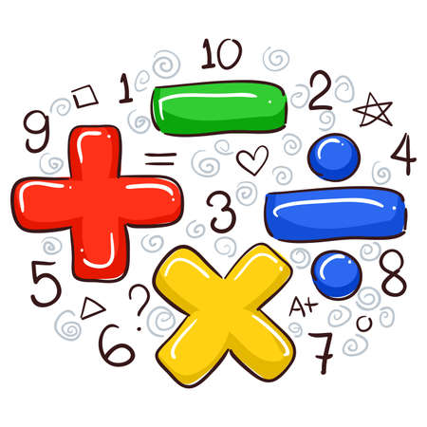
Morning Maths and Weekly Arithmetic Tests
Each morning when the children come into the classroom there is a Morning Maths activity linked to the arithmetic skill they are focusing on that week.
Arithmetic skills vary from basic addition and subtraction, multiplication and division and fractions of an amount for KS1.
Then once the children have learnt these skills they have a weekly arithmetic test to practise these skills. Scores are recorded and tracked by the class teachers and Maths Lead- Miss Uzzell who then uses this information to inform any additional support that might be needed.

Slide 15
Calculation policies
All copies of our Calculation Policies in line with our Power Maths scheme can be found on our school website.
Head to Key Information and then click Policies and Guidance.
All policies for KS1, lower KS2 and Upper KS2 are found here.
https://www.larkrise.essex.sch.uk/policies-and-guidance/

