Slide 1
Maths Enrichment Day
Chelmsford County High School for Girls
15th June

Slide 2
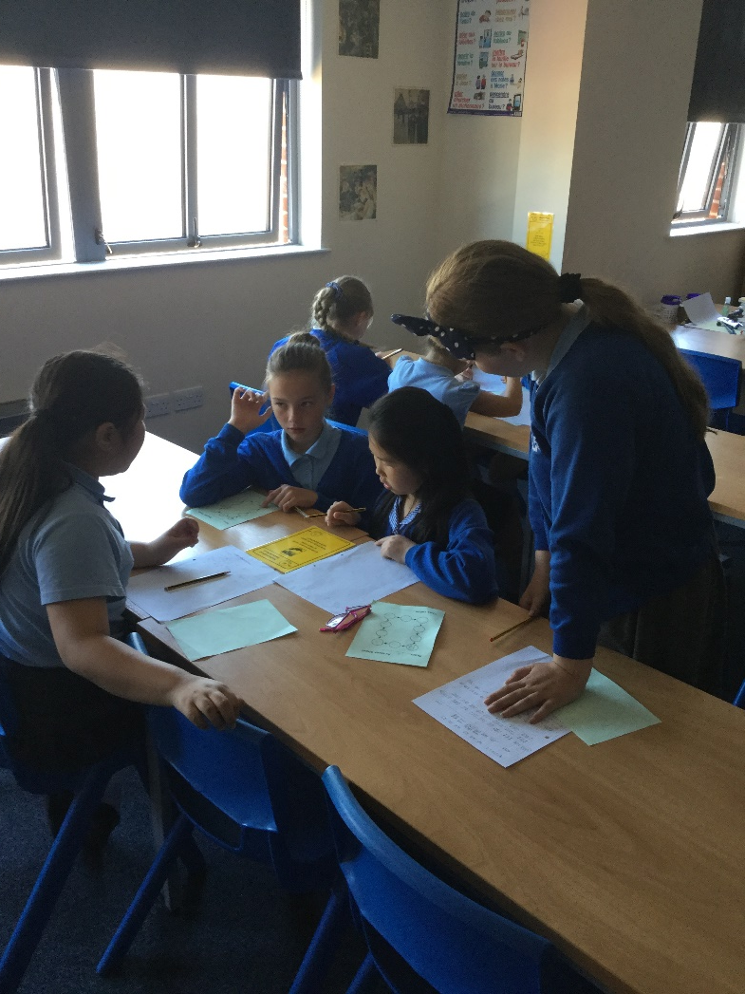
We started with problem solving linked to sequences. We had to investigate patterns within square numbers, triangular numbers, digits within numbers that were added and lots more. Once we worked out the answer it led to the next question

Slide 3
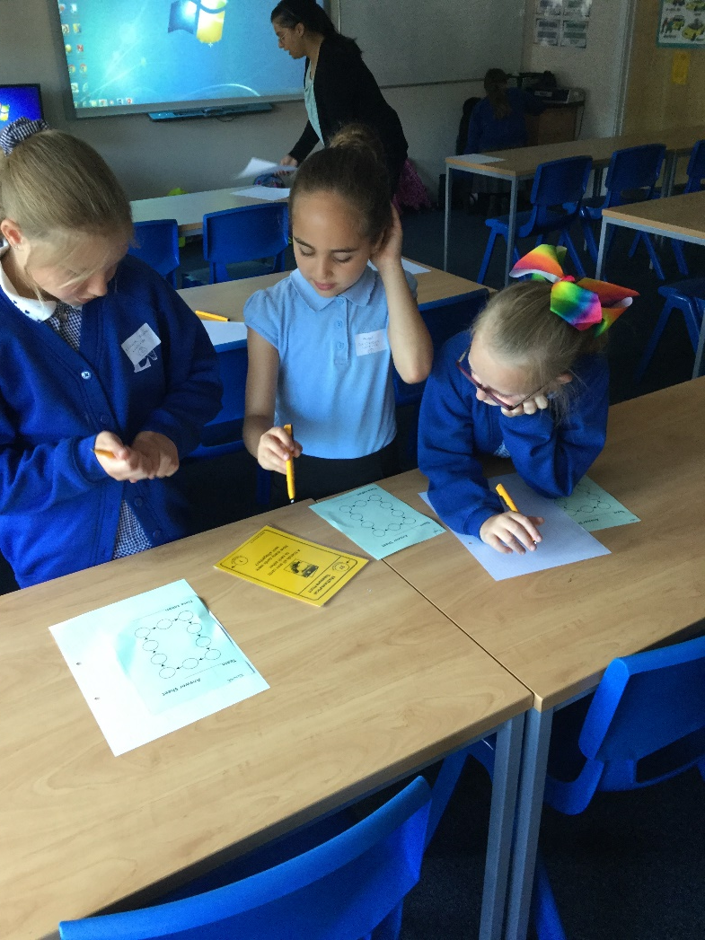
We worked well in our teams…

Slide 4
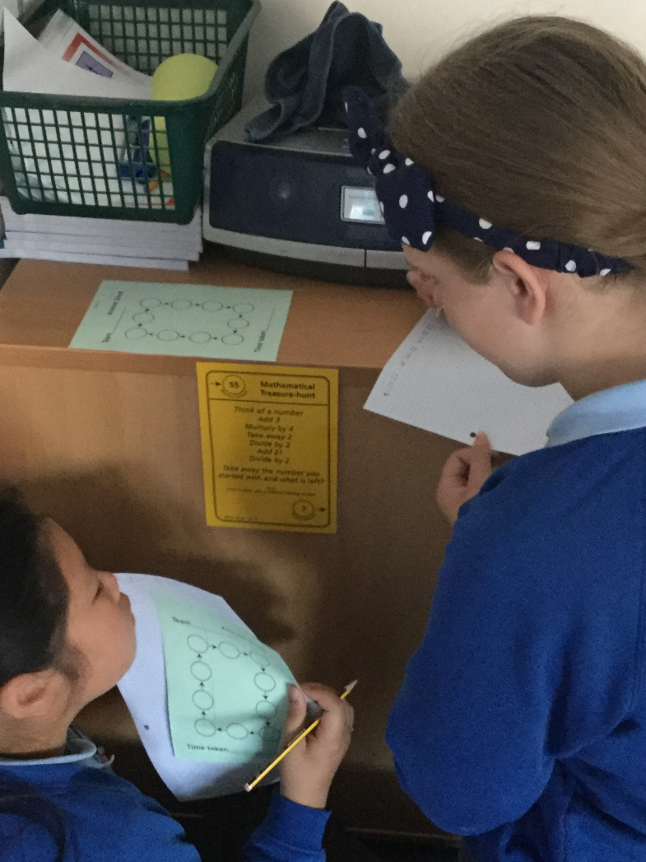
There was lots of talk using the correct vocabulary.

Slide 5
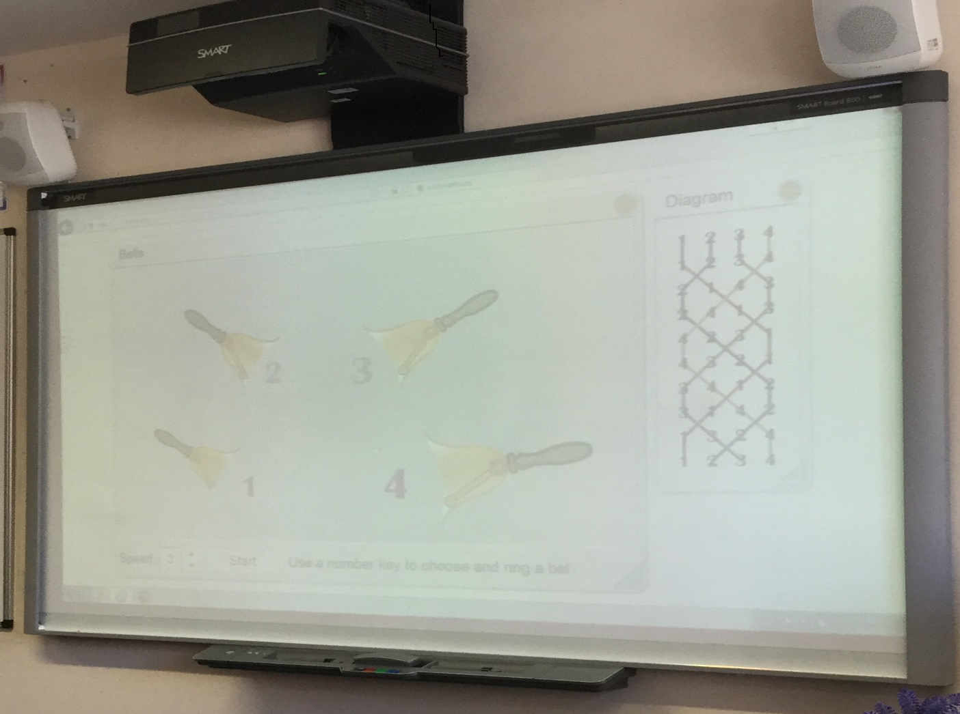
The next task involved maths and music. We had to compose our piece of music, and play it using bells, and record our composition using a numerical system.
If the same number is connected this forms a braid pattern.

Slide 6
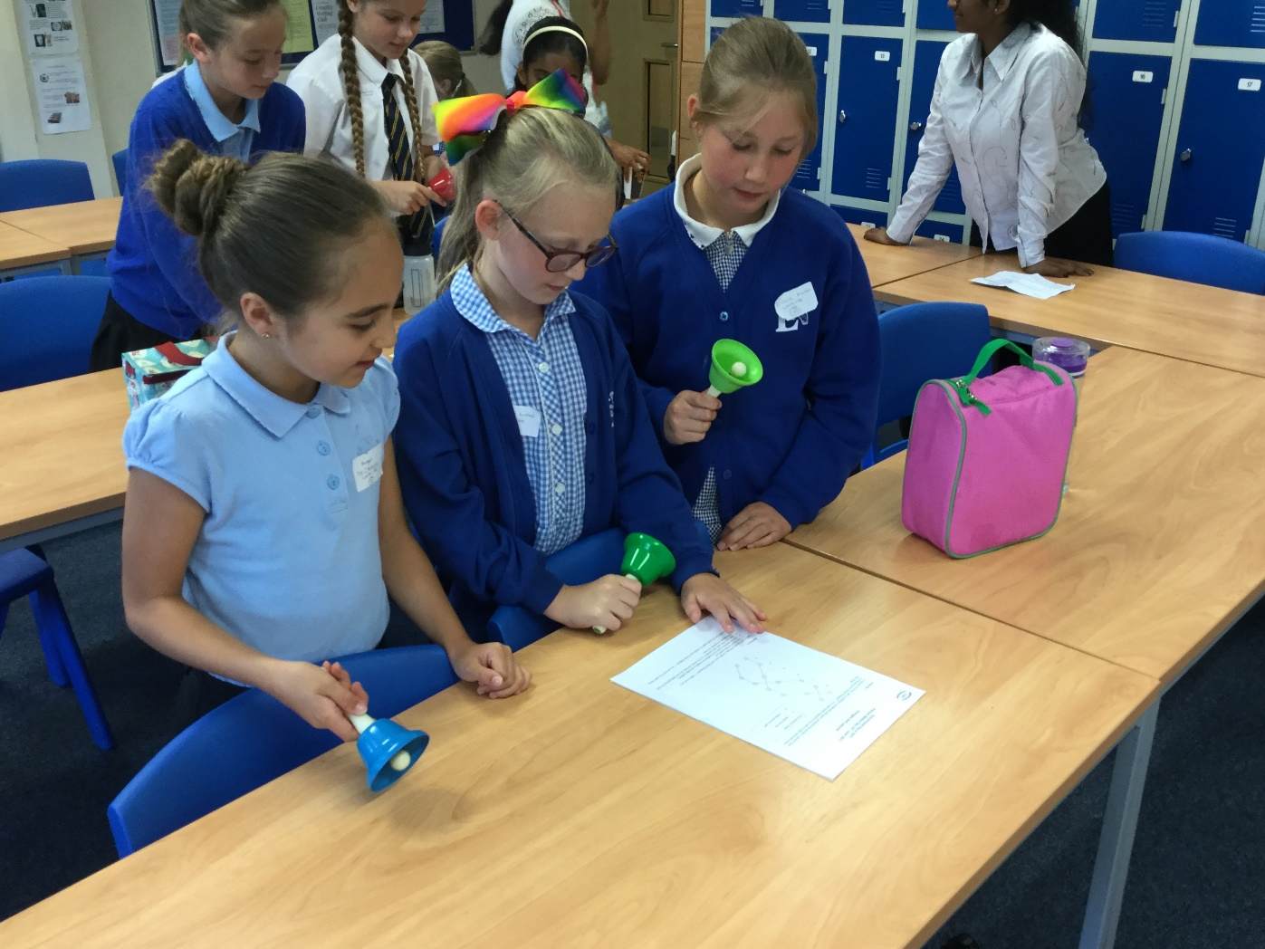
Here we are performing to our group.

Slide 7
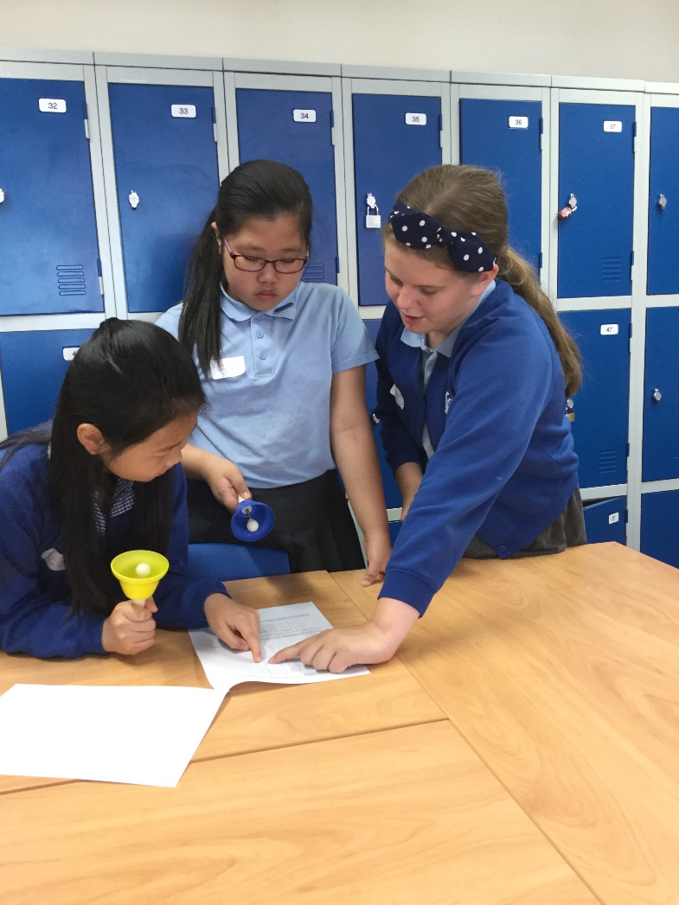
This is our Year five girls composing.

Slide 8
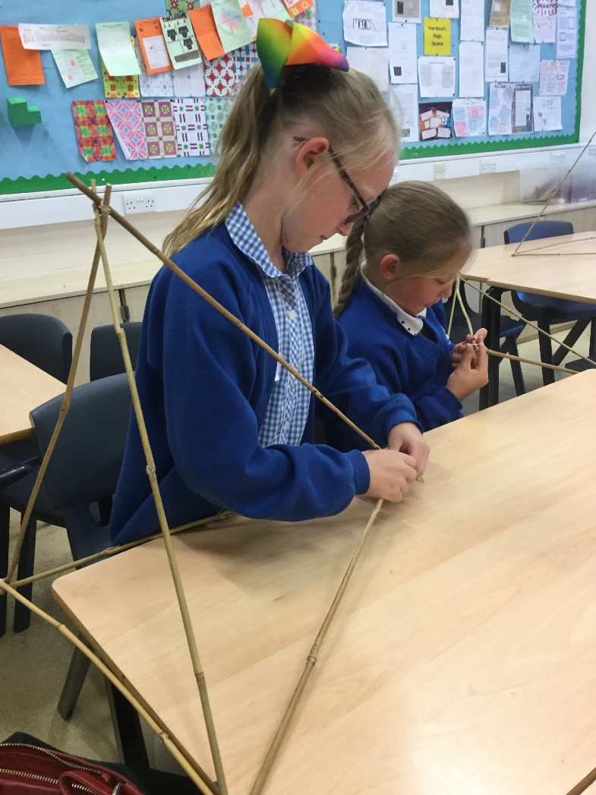
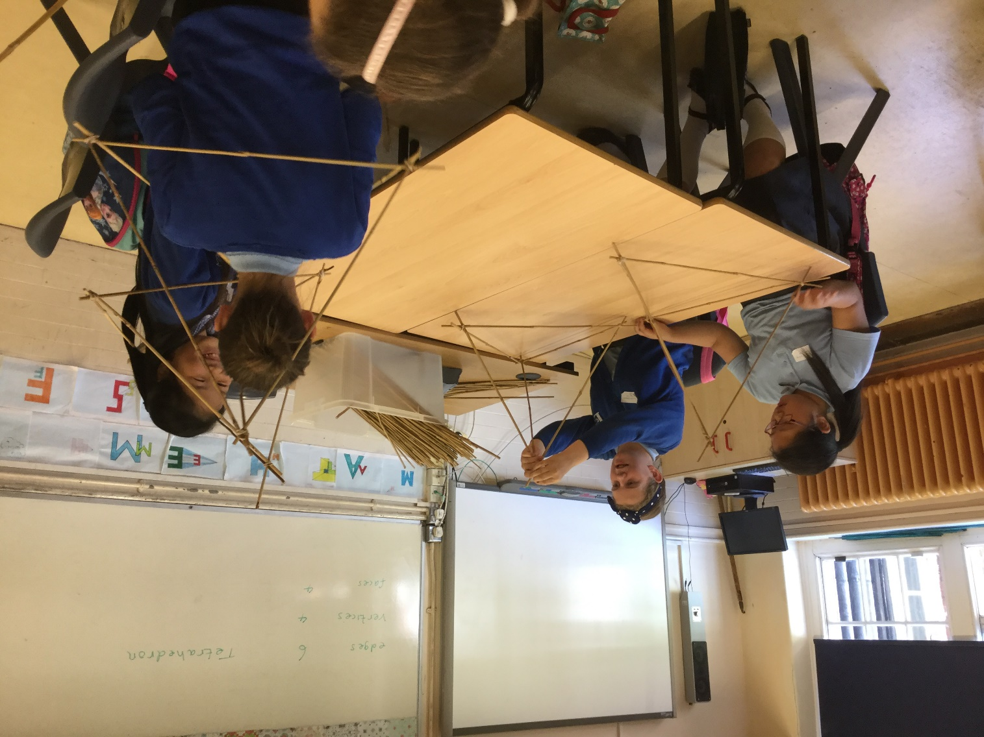
We then investigated shape, specifically tetrahedrons.

Slide 9
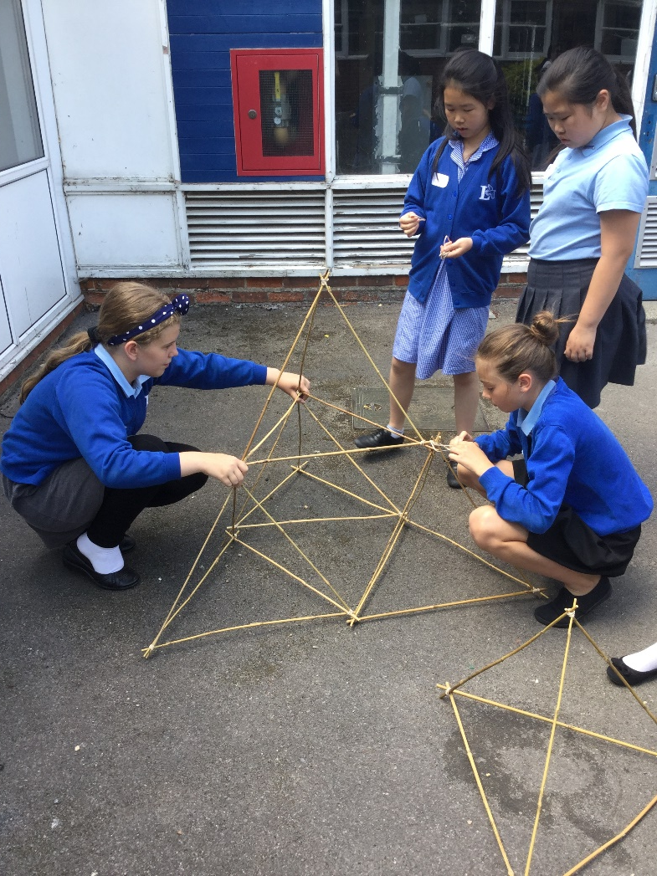
We connected four of our tetrahedrons together to create this one.

Slide 10
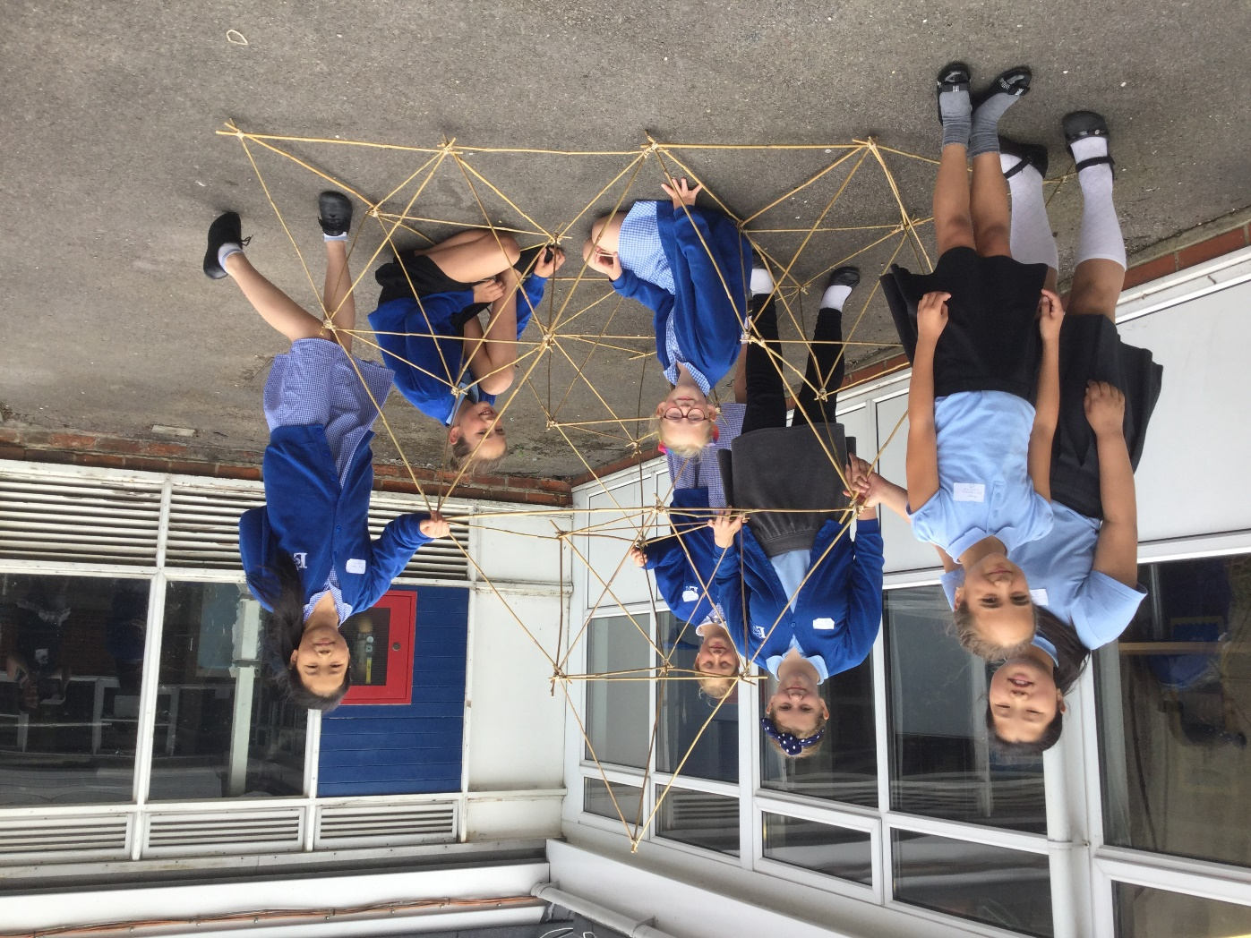
We then connected four of those tetrahedrons to create this. We calculated that is must have 96 canes within it.

Slide 11
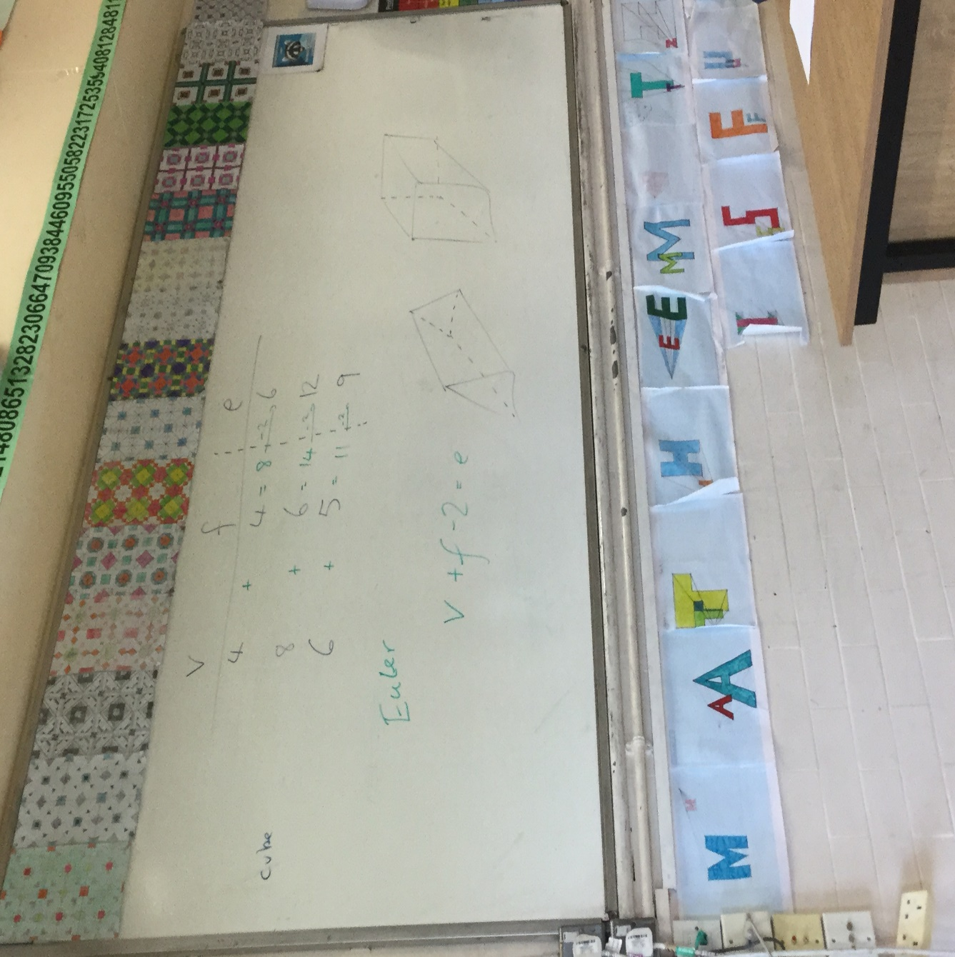
Afterwards, we investigated the pattern between vertices, faces and edges. We found one! Just as the mathematician Euler had before.

Slide 12
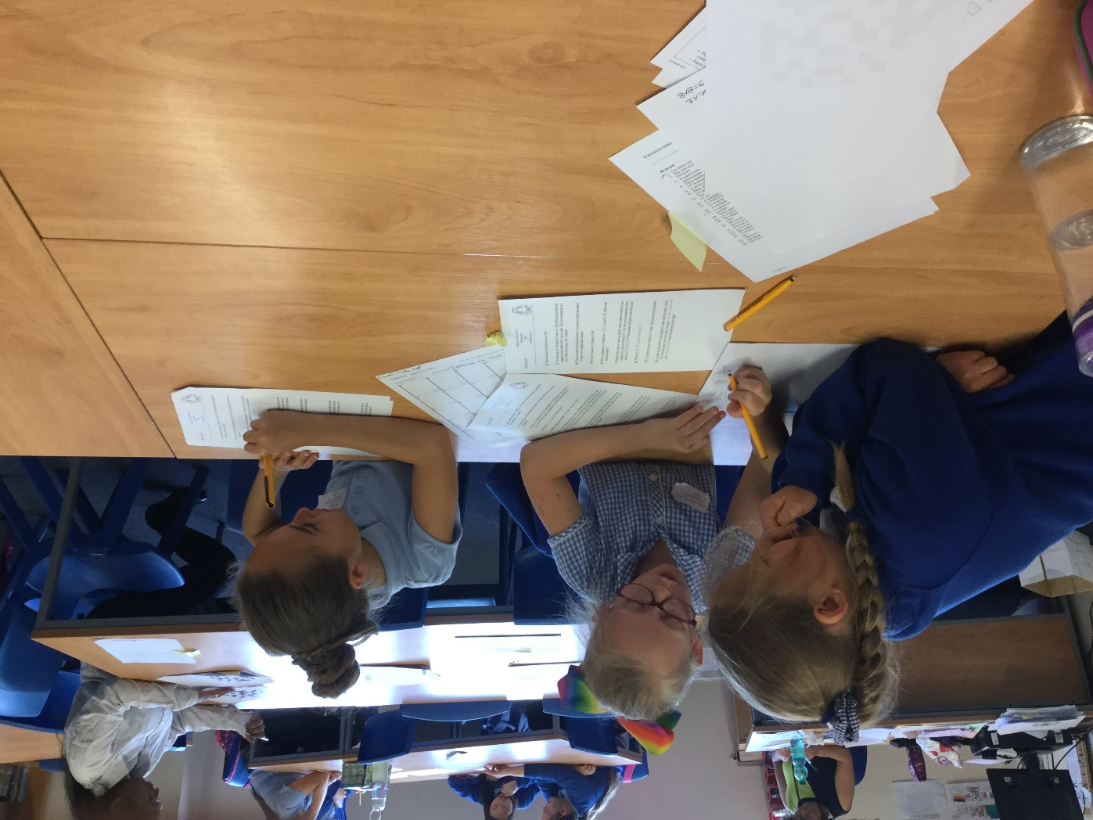
We finished the day with a little Maths challenge (It was really hard!)

Slide 13
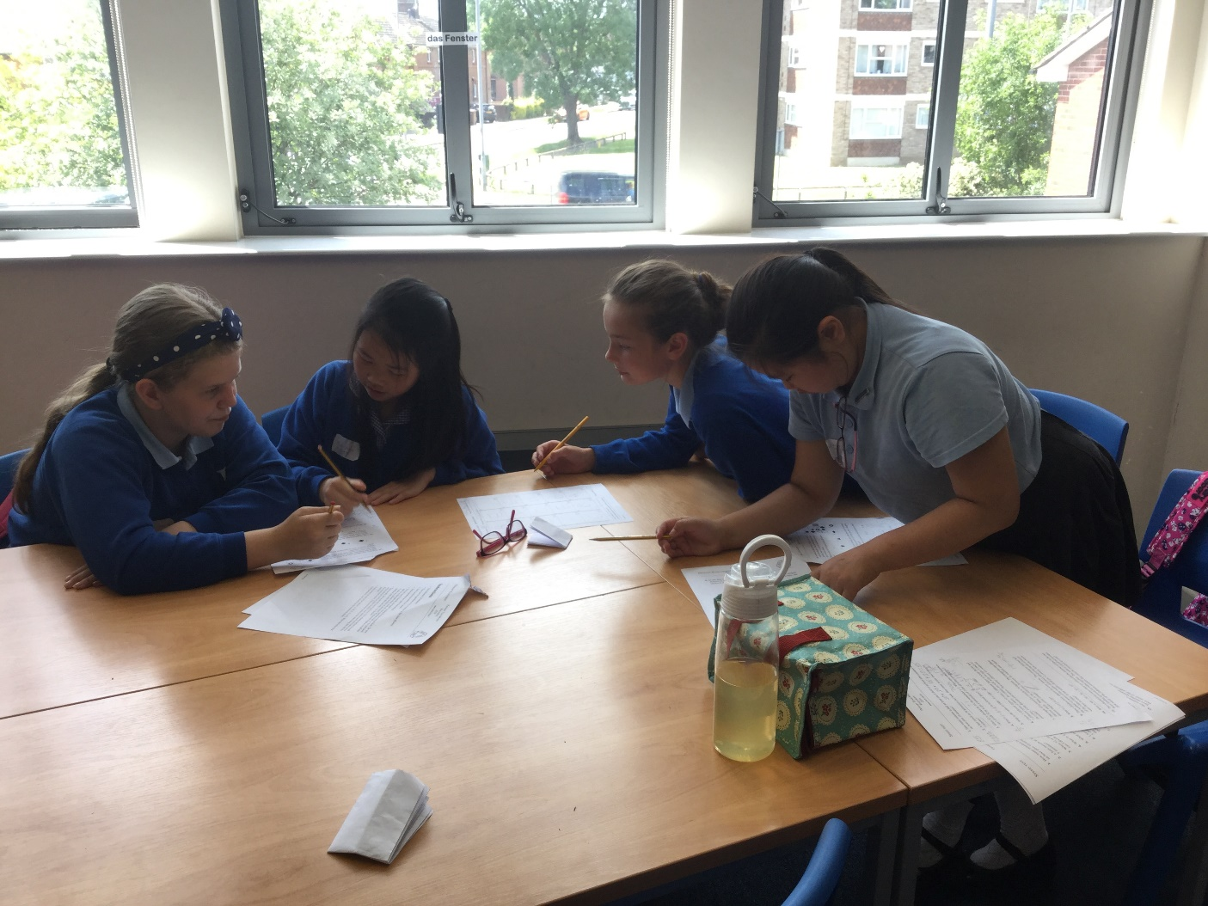
We worked in teams and had three ‘challenges’ to complete in twenty minutes each time

Slide 14
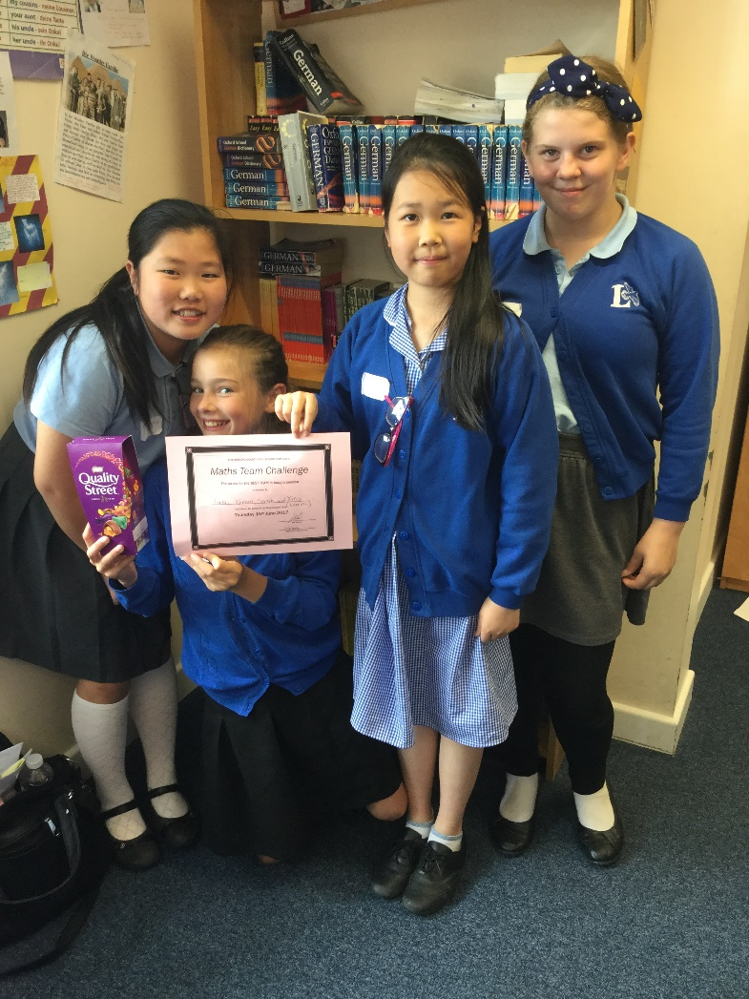
But we won! We didn’t mind how hard they were anymore.

